Slide 1
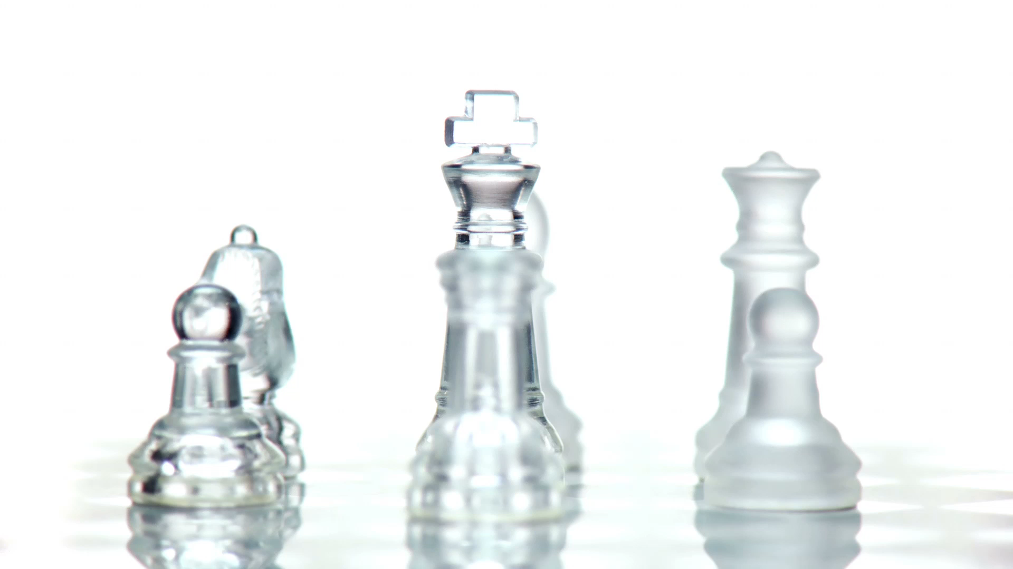
Chess Data Scraper Project
Hussein Rizkana

Slide 2
Contents
Dataset description
Possible Uses
Data acquisition
Data Cleaning
Data Storage

Slide 3
The Dataset
The data set consists of chess games played in January of year 2020 by all GM’s on Chess.com but is easily scalable
Accessory information is the focus of this dataset
Players: player_id, username, name, join date, country code, streamer status, title
moves : game_id, move number , white move, white clock, black move, black clock
games : game_id, player black username, player white username, result black, result white, game mode, time control, increment , date, opening, white elo, black elo, start time"

Slide 4
Target and Possible Uses
Time of day and method of play
Time of day and win rate
Country and opening chosen
Average time per move depending on opponent ranking

Slide 5
Data Acquisition
Data was all scraped off chess.com:
Chessdotcom API was used to retrieve usernames with a given title using ‘get_titled_players”function and “get_player_games_by_month” to retrieve all games for a given month in json format
Requests library was used to retrieve data about the player with the given username to directly interact with the chess.com API using a get request

Slide 6
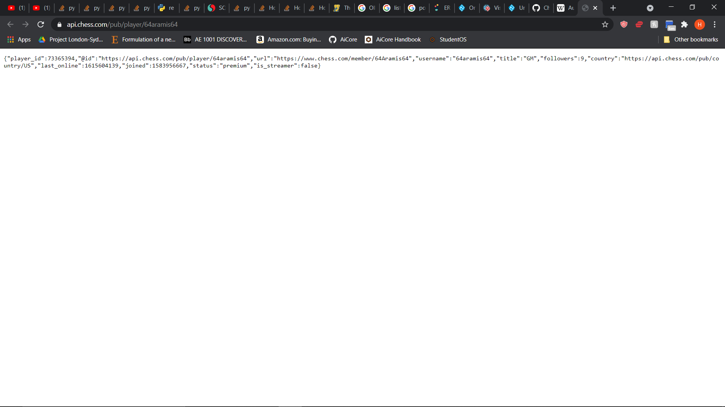
"url": "https://www.chess.com/game/live/5891268179",
"pgn": "[Event \"Live Chess\"]\n[Site \"Chess.com\"]\n[Date \"2020.12.05\"]\n[Round \"-\"]\n[White \"daika91\"]\n[Black \"123lt\"]\n[Result \"1-0\"]\n[CurrentPosition \"8/5Rpk/5Ppp/p1b2n2/P1p4P/7K/2P3Q1/8 b - -\"]\n[Timezone \"UTC\"]\n[ECO \"D00\"]\n[ECOUrl \"https://www.chess.com/openings/Queens-Pawn-Opening-Accelerated-London-System\"]\n[UTCDate \"2020.12.05\"]\n[UTCTime \"09:00:45\"]\n[WhiteElo \"2525\"]\n[BlackElo \"2455\"]\n[TimeControl \"900+5\"]\n[Termination \"daika91 won by resignation\"]\n[StartTime \"09:00:45\"]\n[EndDate \"2020.12.05\"]\n[EndTime \"09:36:37\"]\n[Link \"https://www.chess.com/game/live/5891268179\"]\n\n1. d4 {[%clk 0:15:03.8]} 1... d5 {[%clk 0:15:02.6]} 2. Bf4 {[%clk 0:15:06.6]} 2... Nf6 {[%clk 0:15:05.6]} 3. e3 {[%clk 0:15:05.5]} 3... c5 {[%clk 0:15:08]} 4. Nf3 {[%clk 0:14:55.8]} 4... Nc6 {[%clk 0:14:40.3]} 5. Nbd2 {[%clk 0:14:58.4]} 5... cxd4 {[%clk 0:14:39.3]} 6. exd4 {[%clk 0:15:01.5]} 6... Qb6 {[%clk 0:14:41.6]} 7. Nb3 {[%clk 0:15:04.6]} 7... Bf5 {[%clk 0:14:45.7]} 8. a4 {[%clk 0:15:05]} 8... a5 {[%clk 0:13:48.4]} 9. Bb5 {[%clk 0:15:05.7]} 9... e6 {[%clk 0:13:44.3]} 10. O-O {[%clk 0:15:03]} 10... Be7 {[%clk 0:13:40.7]} 11. Ne5 {[%clk 0:13:47.9]} 11... O-O {[%clk 0:13:31.1]} 12. Bxc6 {[%clk 0:09:40.2]} 12... bxc6 {[%clk 0:13:28.2]} 13. g4 {[%clk 0:09:43.6]} 13... Bg6 {[%clk 0:11:43.5]} 14. h4 {[%clk 0:09:46.6]} 14... h6 {[%clk 0:10:51]} 15. Qe2 {[%clk 0:09:26.6]} 15... Qb7 {[%clk 0:09:52.1]} 16. Nxg6 {[%clk 0:07:27.4]} 16... fxg6 {[%clk 0:09:55]} 17. Qxe6+ {[%clk 0:07:18.8]} 17... Kh7 {[%clk 0:09:39.9]} 18. Be5 {[%clk 0:06:19.8]} 18... Rae8 {[%clk 0:07:39.6]} 19. g5 {[%clk 0:06:18.9]} 19... Nh5 {[%clk 0:04:54.5]} 20. Qg4 {[%clk 0:06:21.4]} 20... c5 {[%clk 0:03:20.1]} 21. f4 {[%clk 0:06:23.5]} 21... c4 {[%clk 0:02:42.8]} 22. Nc5 {[%clk 0:05:57]} 22... Qxb2 {[%clk 0:01:48.9]} 23. Ne6 {[%clk 0:03:46.9]} 23... Rf5 {[%clk 0:01:18.3]} 24. Qg2 {[%clk 0:03:50]} 24... Bb4 {[%clk 0:00:33.4]} 25. Rab1 {[%clk 0:03:35.5]} 25... Qa3 {[%clk 0:00:31.2]} 26. Nc7 {[%clk 0:03:07.8]} 26... Rexe5 {[%clk 0:00:32.4]} 27. fxe5 {[%clk 0:03:09.9]} 27... Qe3+ {[%clk 0:00:30.3]} 28. Kh2 {[%clk 0:03:12.1]} 28... Rxf1 {[%clk 0:00:23.4]} 29. Rxf1 {[%clk 0:03:14.2]} 29... Qxd4 {[%clk 0:00:27.2]} 30. Nxd5 {[%clk 0:01:55.8]} 30... Qxe5+ {[%clk 0:00:30.3]} 31. Kh3 {[%clk 0:01:42.4]} 31... Qe6+ {[%clk 0:00:33.5]} 32. Kh2 {[%clk 0:01:45.3]} 32... Bd6+ {[%clk 0:00:36.7]} 33. Kg1 {[%clk 0:01:48.3]} 33... Qe5 {[%clk 0:00:16.9]} 34. Rf7 {[%clk 0:00:23.6]} 34... Bc5+ {[%clk 0:00:19.4]} 35. Kh1 {[%clk 0:00:25.5]} 35... Ng3+ {[%clk 0:00:22.8]} 36. Kh2 {[%clk 0:00:28.6]} 36... Nf5+ {[%clk 0:00:22.6]} 37. Kh3 {[%clk 0:00:28.3]} 37... Qd4 {[%clk 0:00:26.5]} 38. Nf6+ {[%clk 0:00:29.6]} 38... Qxf6 {[%clk 0:00:24.5]} 39. gxf6 {[%clk 0:00:32.1]} 1-0",
"time_control": "900+5",
"end_time": 1607160997,
"rated": true,
"fen": "8/5Rpk/5Ppp/p1b2n2/P1p4P/7K/2P3Q1/8 b - -",
"time_class": "rapid",
"rules": "chess",
"white": {
"rating": 2525,
"result": "win",
"@id": "https://api.chess.com/pub/player/daika91",
"username": "daika91"
},
"black": {
"rating": 2455,
"result": "resigned",
"@id": "https://api.chess.com/pub/player/123lt",
"username": "123lt"
}

Slide 7
Data Cleaning
Games ending in a white move have null values for black move for the same move number
PGN format is a continuous string and therefore split and replace were used to extract the required data
Not All players have all there values saved in profile

Slide 8
Data Storage
Un-Structured:
Local Storage
Cloud Storage: s3
Structured:
Cloud Storage: RDS(PostgreSQL)

Slide 9
Local
Games were stored per username per year in a given folder with the naming format:“[username]_[year]_games.json”
Using the json library with the json.dump function

Slide 10
Cloud
The same file was stored on the cloud but in string format in the AWS s3 datalake using the boto3 client.
String format was used to save the data as a .txt file

Slide 11
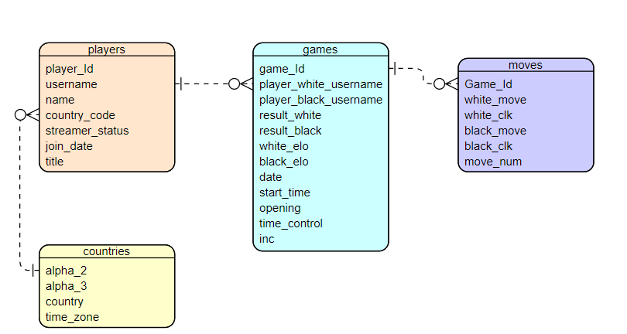
RDS (PostgreSQL) – tables ERD

Slide 12
RDS (PostgreSQL) - Python Implementation
Libraries used: psycopg2, chess
Psycopg2 was used for all sql operations and chess was used to decipher portable game notation into an easier format

Slide 13
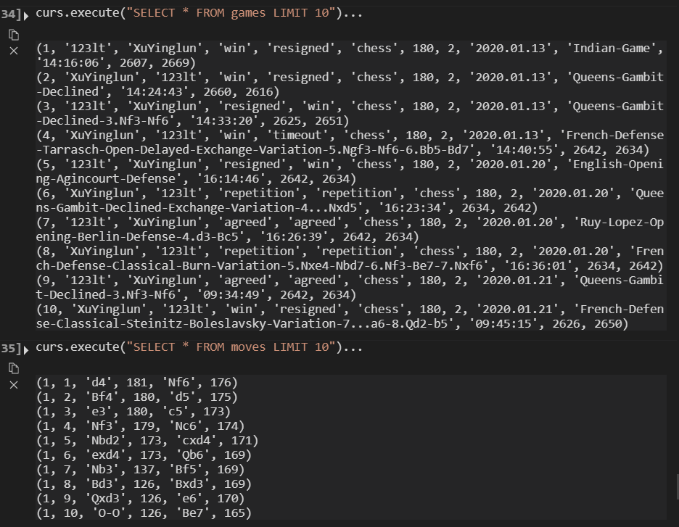
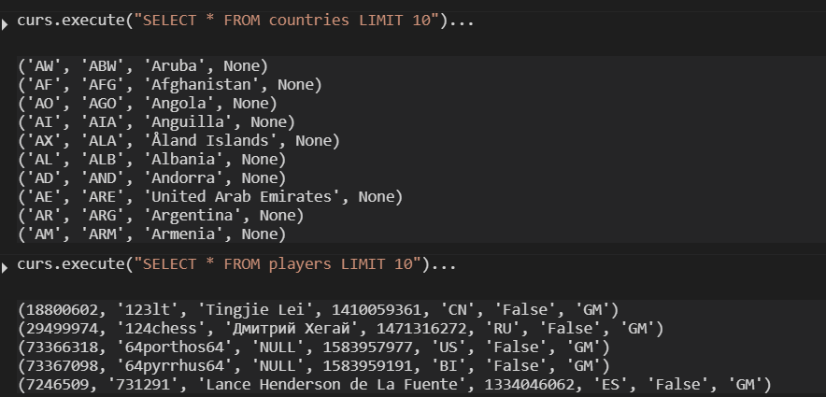
Final result

